Slide 1


Evgenii Merkushin
01.12.2024

Slide 2

Outline
Executive Summary
Introduction
Methodology
Results
Conclusion
Appendix

Slide 3
Executive Summary
Summary of methodologies
SpaceX rocket launch data is collected using SpaceX API and web scraping with Requests and BeutifulSoup Python’s packages
Work with missing values and categorical independent variables (Launch sites, Orbits, Landing outcomes) and create a label with `1` means the booster successfully landed `0` means it was unsuccessful
Perform exploratory data analysis (EDA) using visualization and SQL
Perform interactive visual analytics using Folium and Plotly Dash
Split the data into Train and Test sets, create four classification models: Logistic Regression, SVM, Classification Trees and KNN, tune the best Hyperparameter for each model, evaluate each model based with confusion matrices and find the method performs best using test data
Summary of all results
The best classification model derived from Jaccard index and 20% Test set to predict success of First Stage Landing is tree. Jaccard index for this model is 92.3%

Slide 4
Introduction
Project background and context
SpaceX is the only private company ever to return a spacecraft from low-earth orbit, which it first accomplished in December 2010.
SpaceX advertises Falcon 9 rocket launches on its website with a cost of 62 million dollars whereas other providers cost upward of 165 million dollars each, much of the savings is because Space X can reuse the first stage.
Problems you want to find answers
Therefore, if we can determine if the first stage will land, we can determine the cost of a launch.
This information can be used if an alternate company wants to bid against SpaceX for a rocket launch.

Slide 5

Section 1

Slide 6
Methodology
Executive Summary
Data collection methodology:
SpaceX rocket launch data is collected using SpaceX API and web scraping with Requests and BeutifulSoup Python’s packages
Perform data wrangling
Work with missing values and categorical independent variables (Launch sites, Orbits, Landing outcomes) and create a label with `1` means the booster successfully landed `0` means it was unsuccessful
Perform exploratory data analysis (EDA) using visualization and SQL
Perform interactive visual analytics using Folium and Plotly Dash
Perform predictive analysis using classification models
Split the data into Train and Test sets, create four classification models: Logistic Regression, SVM, Classification Trees and KNN, tune the best Hyperparameter for each model, evaluate each model based with confusion matrices and find the method performs best using test data

Slide 7
Data Collection
SpaceX API
Request and parse the SpaceX launch data using the GET request
Filter the data frame to only include `Falcon 9` launches
Dealing with Missing Values
Web Scraping
Request the Falcon9 Launch Wiki page from its URL
Extract all column/variable names from the HTML table header
Create a data frame by parsing the launch HTML tables
I

Slide 8
Data Collection – SpaceX API
Rocket launch data from SpaceX API
spacex_url=https://api.spacexdata.com/v4/launches/past
response = requests.get(spacex_url)
data = pd.json_normalize(response.json())
Subset of our dataframe keeping only the features we want
data = data[['rocket', 'payloads', 'launchpad', 'cores', 'flight_number', 'date_utc']]
Filter the dataframe to only include `Falcon 9` launches
condition = data['BoosterVersion']!='Falcon 1'
data_falcon9 = data[condition]
Dealing with missing values of PayloadMass
mean_payloadmass = data_falcon9['PayloadMass'].mean()
data_falcon9["PayloadMass"].replace(np.nan, mean_payloadmass, inplace=True)
Export collected data set to CSV
data_falcon9.to_csv('dataset_part_1.csv', index=False)
GitHub URL: https://github.com/emerkushin/testrepo/blob/main/collect.ipynb

Slide 9
Data Collection - Scraping
Request the Falcon9 Wiki page from URL
static_url = "https://en.wikipedia.org/w/index.php?title=List_of_Falcon_9_and_Falcon_Heavy_launches&oldid=1027686922"
Create a `BeautifulSoup` object from the HTML `response`
soup = BeautifulSoup(data, 'html.parser')
Extract all column/variable names from the HTML table header
th = first_launch_table.find_all('th')
Create a data frame by parsing the launch HTML tables
for table_number,table in enumerate(soup.find_all('table',"wikitable plainrowheaders collapsible")):
Export collected data set to CSV
data_falcon9.to_csv('dataset_part_1.csv', index=False)
GitHub URL: https://github.com/emerkushin/testrepo/blob/main/webscrap.ipynb

Slide 10
Data Wrangling
Load Space X dataset
df=pd.read_csv("https://cf-courses-data.s3.us.cloud-object-storage.appdomain.cloud/IBM-DS0321EN-SkillsNetwork/datasets/dataset_part_1.csv")
Count numbers of categorical independent variables:
- Launch sites
- Orbits
- Landing outcomes
df['LaunchSite'].value_counts()
df['Orbit'].value_counts()
landing_outcomes = df['Outcome'].value_counts()
Create a landing outcome label from Outcome column
for outcome in landing:
if (outcome in bad_outcomes):
x = 0
else:
x = 1
landing_class.append(x)
Export collected data set to CSV
df.to_csv("dataset_part_2.csv", index=False)
GitHub URL: https://github.com/emerkushin/testrepo/blob/main/wrangle.ipynb

Slide 11
EDA with Data Visualization
Visualize the relationship between Flight Number and Launch Site
Visualize the relationship between Payload Mass and Launch Site
Visualize the relationship between success rate of each orbit type
Visualize the relationship between FlightNumber and Orbit type
Visualize the relationship between Payload Mass and Orbit type
Visualize the launch success yearly trend
GitHub URL: https://github.com/emerkushin/testrepo/blob/main/edadataviz.ipynb

Slide 12
EDA with SQL
Display the names of the unique launch sites in the space mission
Display 5 records where launch sites begin with the string 'CCA'
Display the total payload mass carried by boosters launched by NASA (CRS)
Display average payload mass carried by booster version F9 v1.1
List the date when the first succesful landing outcome in ground pad was acheived
List the names of the boosters which have success in drone ship and have payload mass greater than 4000 but less than 6000
List the total number of successful and failure mission outcomes
List the names of the booster_versions which have carried the maximum payload mass. Use a subquery
List the records which will display the month names, failure landing_outcomes in drone ship ,booster versions, launch_site for the months in year 2015
Rank the count of landing outcomes (such as Failure (drone ship) or Success (ground pad)) between the date 2010-06-04 and 2017-03-20, in descending order
GitHub URL: https://github.com/emerkushin/testrepo/blob/main/eda_sql.ipynb

Slide 13
Build an Interactive Map with Folium
The following map objects were created and added to a folium map:
`folium.Circle` to add a highlighted circle area with a text label on a specific coordinate
`folium.Marker` to mark launch sites
`MarkerCluster` to mark the success/failed launches for each site on the map
`MousePosition` on the map to get coordinate for a mouse over a point on the map
`folium.PolyLine` to indicate the distance between a launch site to the selected coastline point
GitHub URL: https://github.com/emerkushin/testrepo/blob/main/folium.ipynb

Slide 14
Build a Dashboard with Plotly Dash
The following plots/graphs and interactions were added to a dashboard:
a pie chart to show the total successful launches count for all sites
pie charts to display the Success vs. Failed counts for the specific launch site
a slider to select payload range
scatter charts to show the correlation between payload and launch success for the specific launch site
GitHub URL: https://github.com/emerkushin/testrepo/blob/main/lab_dash.py

Slide 15
Predictive Analysis (Classification)
Create a NumPy array from the column Class and standardize the data in X
Y = data['Class'].to_numpy()
X = preprocessing.StandardScaler().fit(X).transform(X.astype(float)
To split the data X and Y into training and test data
X_train, X_test, Y_train, Y_test = train_test_split( X, Y, test_size=0.2, random_state=2)
Train four classification models (logistic regression, SVM, tree and knn) with grid search
GridSearchCV()
model.fit()
model.best_params_
model.best_score_
Evaluate models with score and confusion matrices using Test set
jaccard_score(Y_test, Y_pred)
plot_confusion_matrix(Y_test,yhat)
Find the best model using confusion matrix and jaccard_score
best_score = max(logreg_score,svm_score,tree_score,knn_score)
GitHub URL: https://github.com/emerkushin/testrepo/blob/main/classification.ipynb
15

Slide 16
Results
Exploratory data analysis results
We have chosen the following independent variables for our model: 'FlightNumber', 'PayloadMass', 'Orbit', 'LaunchSite', 'Flights', 'GridFins', 'Reused', 'Legs', 'LandingPad', 'Block', 'ReusedCount', 'Serial’
We have converted categorical variables Orbits, LaunchSite, LandingPad, and Serial into dummies variables.

Slide 17
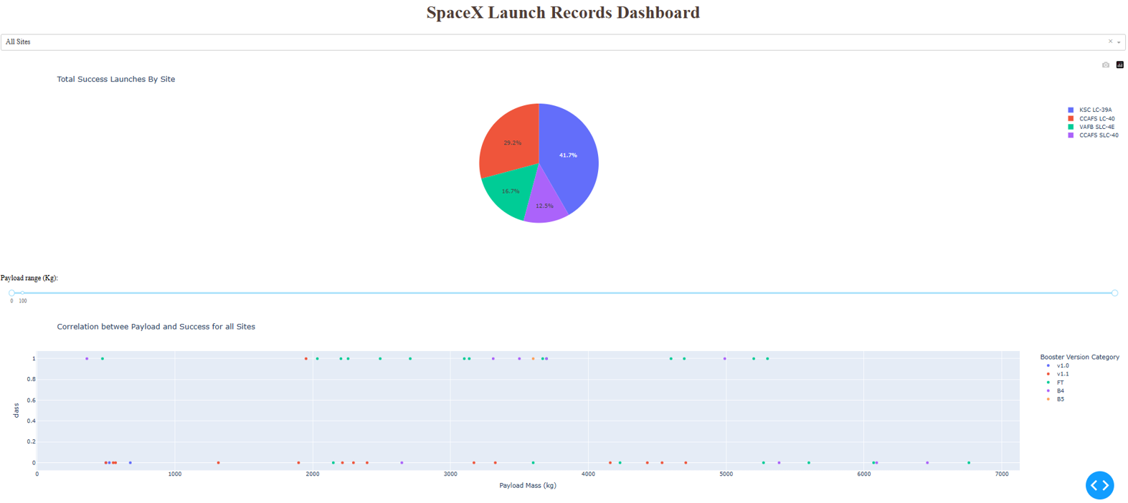
Results
Interactive analytics demo in screenshots

Slide 18
Results
Predictive analysis results
Four models for classification prediction have been tested: logistic regression SVM, tree and knn.
The best model classification model chosen based on Jaccard index and Test set of 20% of data is tree.

Slide 19

Section 2

Slide 20
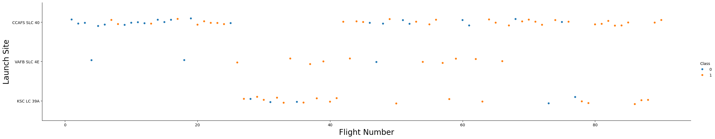
Flight Number vs. Launch Site
Show a scatter plot of Flight Number vs. Launch Site
sns.catplot(y="LaunchSite", x="FlightNumber", hue="Class", data=df, aspect = 5)
plt.xlabel("Flight Number",fontsize=20)
plt.ylabel("Launch Site",fontsize=20)
plt.show()
Show the screenshot of the scatter plot with explanations
Takeaway: the biggest number of launches was from CCAFS SLC-40 launch site

Slide 21
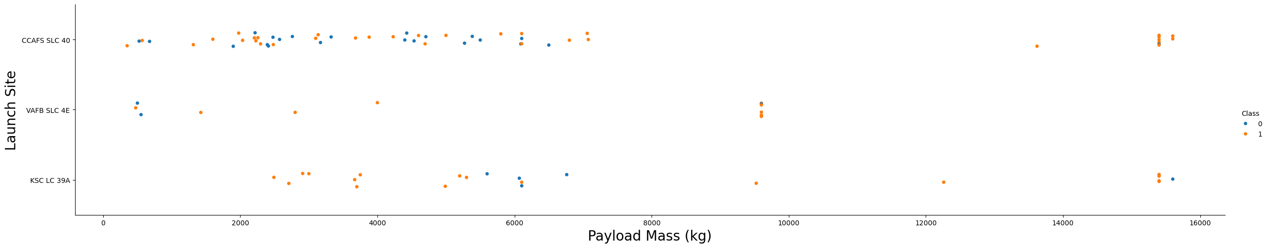
Payload vs. Launch Site
Show a scatter plot of Payload vs. Launch Site
sns.catplot(y="LaunchSite", x="PayloadMass", hue="Class", data=df, aspect = 5)
plt.xlabel("Payload Mass (kg)",fontsize=20)
plt.ylabel("Launch Site",fontsize=20)
plt.show()
Show the screenshot of the scatter plot with explanations
Takeaway: for the VAFB-SLC launchsite there are no rockets launched for heavypayload mass(greater than 10000).

Slide 22
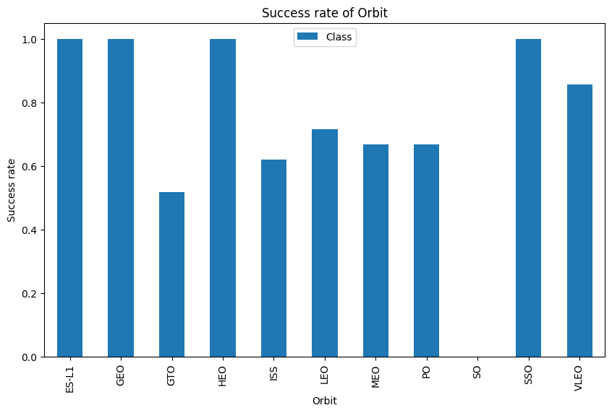
Success Rate vs. Orbit Type
Show a bar chart for the success rate of each orbit type
df_grouped = df.groupby(['Orbit'], as_index=False).agg({'Class': 'mean'})
df_grouped.set_index('Orbit', inplace=True)
df_grouped.plot(kind='bar', figsize=(10, 6), rot=90)
plt.xlabel('Orbit')
plt.ylabel('Success rate')
plt.title('Success rate of Orbit')
plt.show()
Show the screenshot of the bar chart with explanations
Takeaway: ES-L1, GEO, HEO and SSO orbits have the highest success rates (100%)

Slide 23
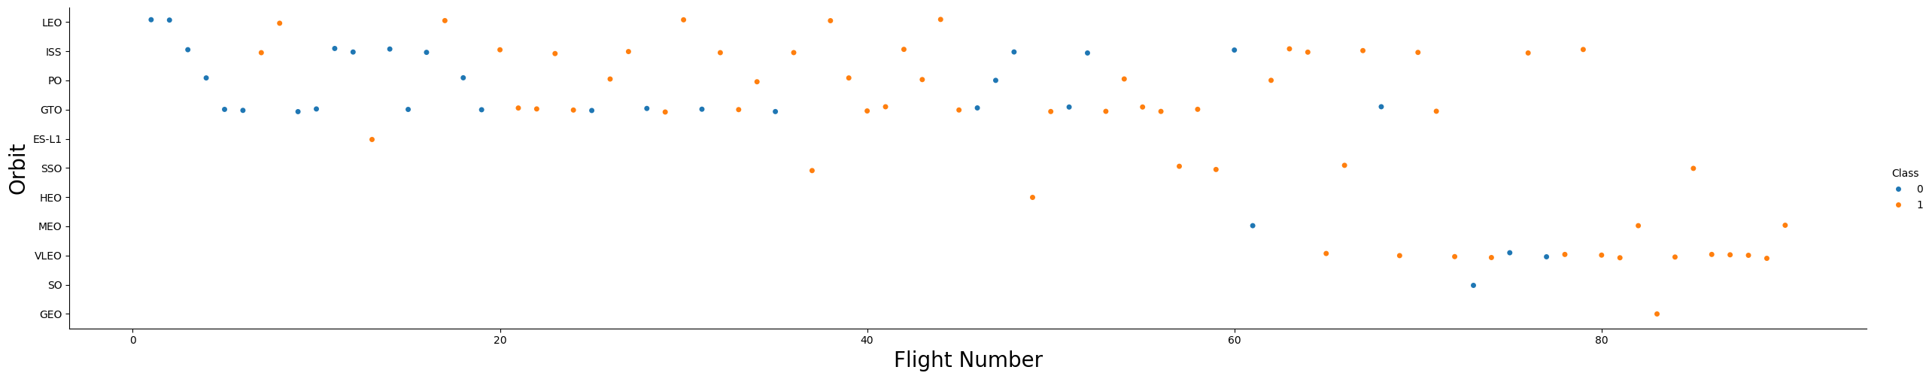
Flight Number vs. Orbit Type
Show a scatter point of Flight number vs. Orbit type
sns.catplot(y="Orbit", x="FlightNumber", hue="Class", data=df, aspect = 5)
plt.xlabel("Flight Number",fontsize=20)
plt.ylabel("Orbit",fontsize=20)
plt.show()
Show the screenshot of the scatter plot with explanations
Takeaway: you can observe that in the LEO orbit, success seems to be related to the number of flights. Conversely, in the GTO orbit, there appears to be no relationship between flight number and success.

Slide 24
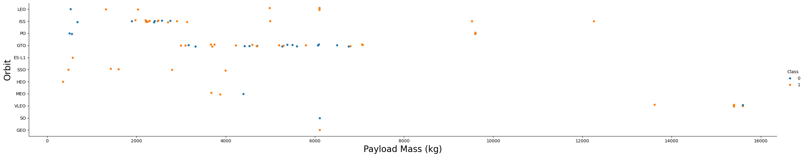
Payload vs. Orbit Type
Show a scatter plot of payload vs. orbit type
sns.catplot(y="Orbit", x="PayloadMass", hue="Class", data=df, aspect = 5)
plt.xlabel("Payload Mass (kg)",fontsize=20)
plt.ylabel("Orbit",fontsize=20)
plt.show()
Show the screenshot of the scatter plot with explanations
Takeaway: with heavy payloads the successful landing or positive landing rate are more for Polar,LEO and ISS. However, for GTO, it's difficult to distinguish between successful and unsuccessful landings as both outcomes are present.

Slide 25
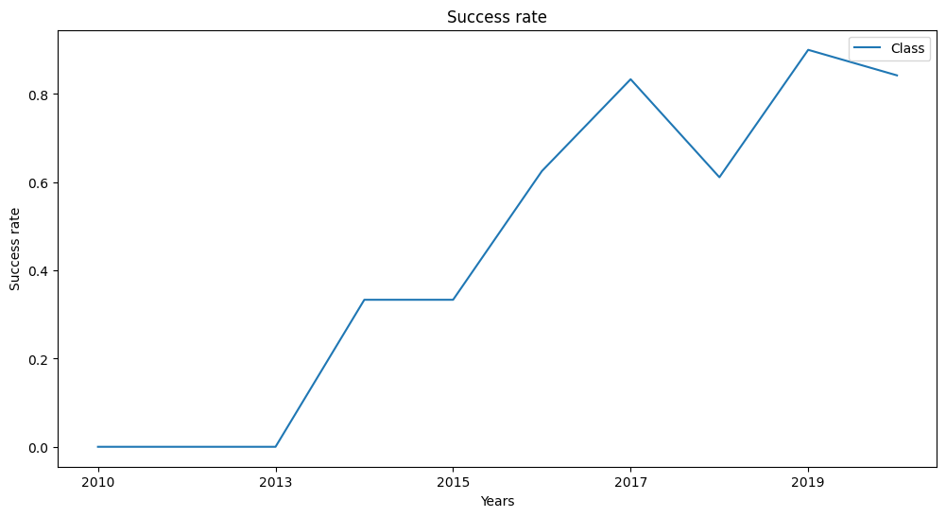
Launch Success Yearly Trend
Show a line chart of yearly average success rate
df_years.plot(kind='line', figsize=(12, 6))
plt.title('Success rate')
plt.ylabel('Success rate')
plt.xlabel('Years')
plt.show()
Show the line chart of the scatter plot with explanations
Takeaway: the success rate since 2013 kept increasing till 2020.

Slide 26
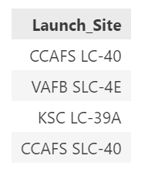
All Launch Site Names
Find the names of the unique launch sites
%sql select DISTINCT Launch_Site from SPACEXTABLE;
Present your query result with a short explanation here
We have found 4 sites

Slide 27
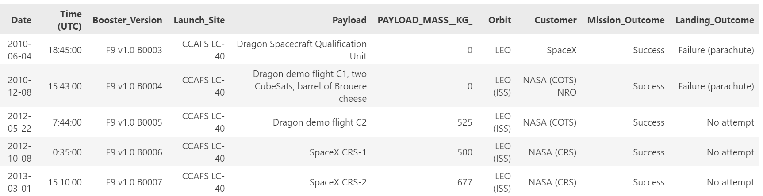
Launch Site Names Begin with 'CCA'
Find 5 records where launch sites begin with `CCA`
%sql select * from SPACEXTABLE where \
Launch_Site LIKE 'CCA%' LIMIT 5;
Present your query result with a short explanation here

Slide 28
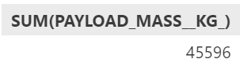
Total Payload Mass
Calculate the total payload carried by boosters from NASA
%sql select SUM(PAYLOAD_MASS__KG_) from SPACEXTABLE where \
Customer = 'NASA (CRS)';
Present your query result with a short explanation here
The result is 45,596 kg

Slide 29
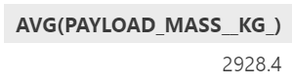
Average Payload Mass by F9 v1.1
Calculate the average payload mass carried by booster version F9 v1.1
%sql select AVG(PAYLOAD_MASS__KG_) from SPACEXTABLE where \
Booster_Version = 'F9 v1.1';
Present your query result with a short explanation here
The result is 2,928.4 kg

Slide 30
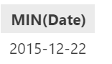
First Successful Ground Landing Date
Find the dates of the first successful landing outcome on ground pad
%sql select MIN(Date) from SPACEXTABLE where \
Landing_Outcome = 'Success (ground pad)';
Present your query result with a short explanation here
The result is 2015-12-22

Slide 31
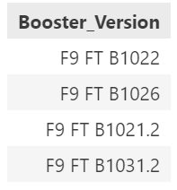
Successful Drone Ship Landing with Payload between 4000 and 6000
List the names of boosters which have successfully landed on drone ship and had payload mass greater than 4000 but less than 6000
%sql select Booster_Version from SPACEXTABLE where \
Landing_Outcome = 'Success (drone ship)' AND \
PAYLOAD_MASS__KG_ > 4000 AND \
PAYLOAD_MASS__KG_ < 6000;
Present your query result with a short explanation here
The result is 4 booster versions.

Slide 32
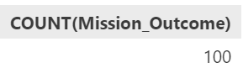
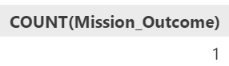
Total Number of Successful and Failure Mission Outcomes
Calculate the total number of successful and failure mission outcomes
%sql select COUNT(Mission_Outcome) from SPACEXTABLE where \
Mission_Outcome LIKE 'Success%';
%sql select COUNT(Mission_Outcome) from SPACEXTABLE where \
Mission_Outcome LIKE 'Failure%';
Present your query result with a short explanation here
The result is 100 successful and 1 failure mission outcomes.

Slide 33
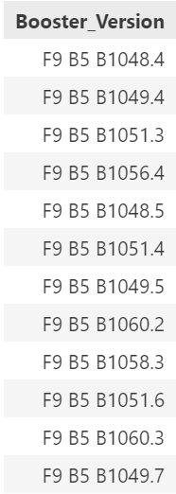
Boosters Carried Maximum Payload
List the names of the booster which have carried the maximum payload mass
%sql select Booster_Version from SPACEXTABLE where \
PAYLOAD_MASS__KG_ = (select MAX(PAYLOAD_MASS__KG_) from SPACEXTABLE);
Present your query result with a short explanation here
The result is the list of 12 boosters.

Slide 34
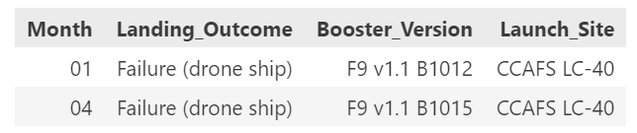
2015 Launch Records
List the failed landing_outcomes in drone ship, their booster versions, and launch site names for in year 2015
%sql select substr(Date, 6,2) as Month, Landing_Outcome, Booster_Version, Launch_Site from SPACEXTABLE where \
substr(Date,0,5)='2015' AND \
Landing_Outcome = 'Failure (drone ship)';
Present your query result with a short explanation here

Slide 35
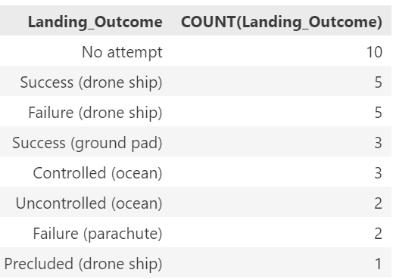
Rank Landing Outcomes Between 2010-06-04 and 2017-03-20
Rank the count of landing outcomes (such as Failure (drone ship) or Success (ground pad)) between the date 2010-06-04 and 2017-03-20, in descending order
%sql select Landing_Outcome, COUNT(Landing_Outcome) \
from SPACEXTABLE where\
Date BETWEEN '2010-06-04' AND '2017-03-20' \
GROUP BY Landing_Outcome \
ORDER BY COUNT(Landing_Outcome) DESC;

Slide 36

Section 3

Slide 37
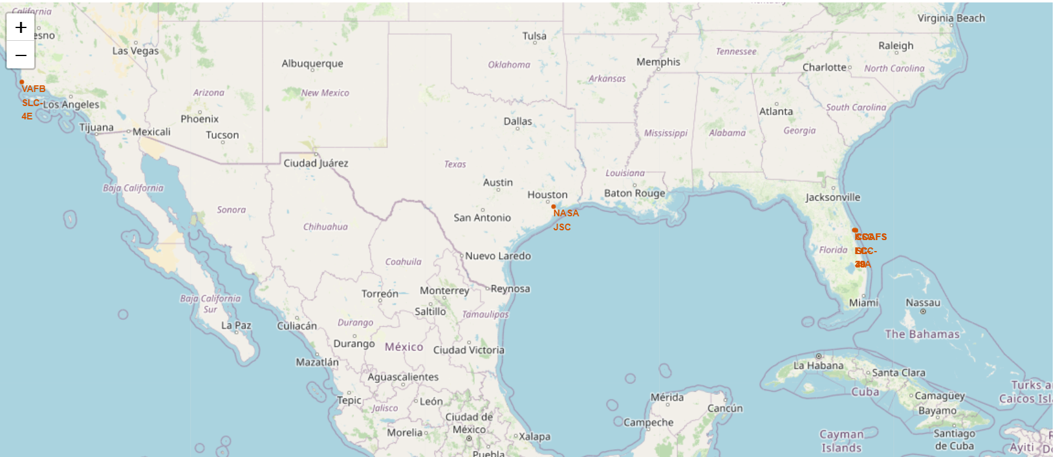
All launch sites’ locations
There are two main launch sites for Space X: VAFB SLC-4E in California and 3 close locations in Florida (CCAFC LC-40, KSC LC-39A, CCAFC SLC-40)

Slide 38
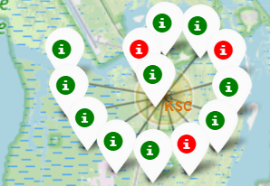
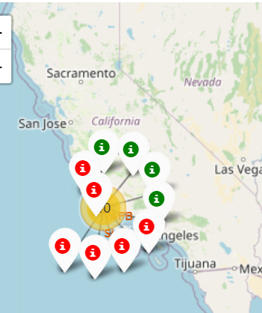
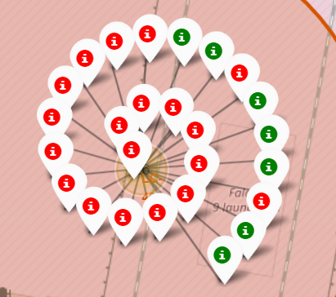
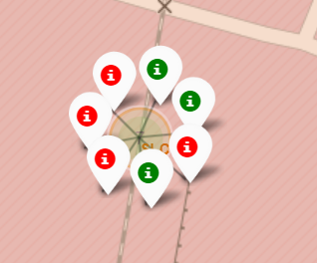
The success/failed launches for each site on the map
The success launch is marked in green, the failed in red.
VAFB SLC-4E site in California
KSC LC-39A in Florida
CCAFC LC-40 in Florida
CCAFC SLC-40in Florida

Slide 39
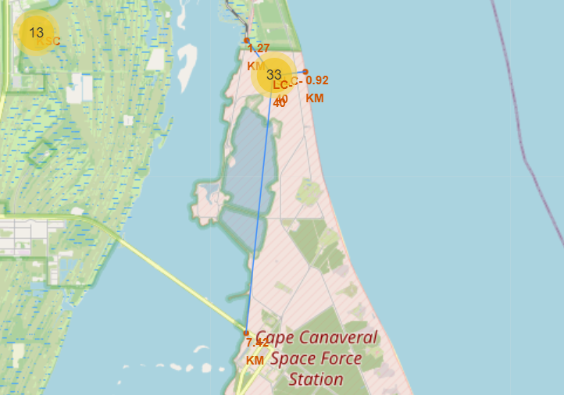
CCAFC LC-40 launch site to its proximities
Distances from CCAFC LC-40 launch site:
To coast: 0.92 km
To railroad: 1.27 km
To highway: 7.42 km

Slide 40

Section 4

Slide 41
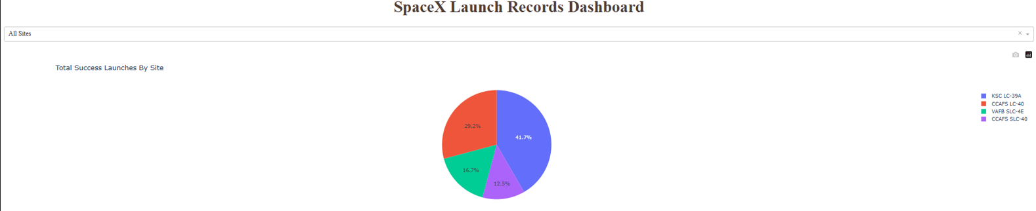
Total success launches by Site
Takeaway: the biggest share of success launches belons to KSC LC-39A launch site

Slide 42
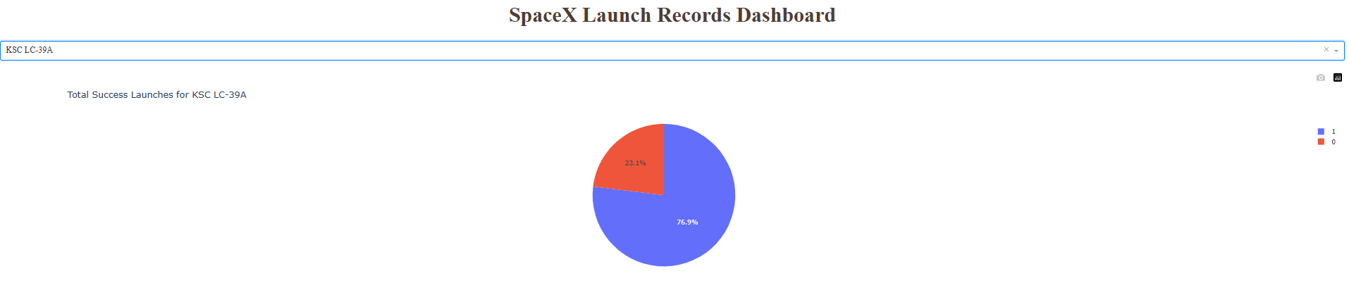
The launch site with highest launch success ratio
Takeaway: the launch site with highest launch success ratio (76.9%) is KSC LC-39A

Slide 43
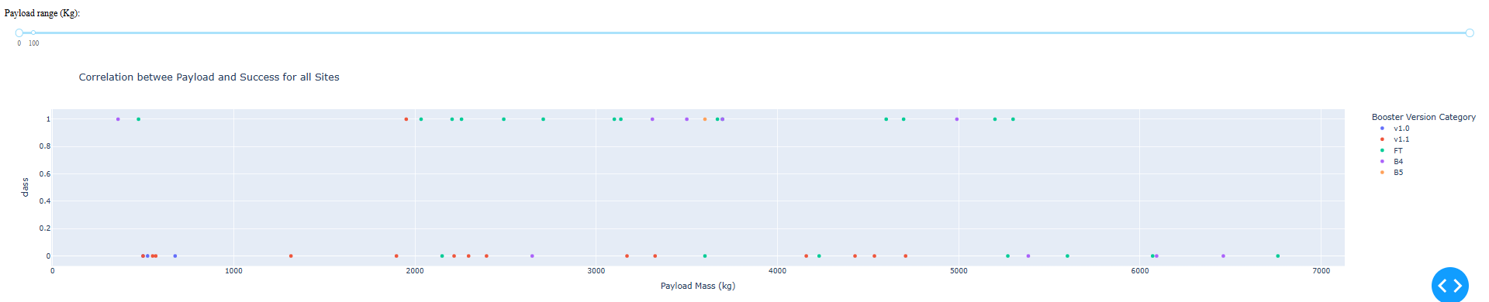
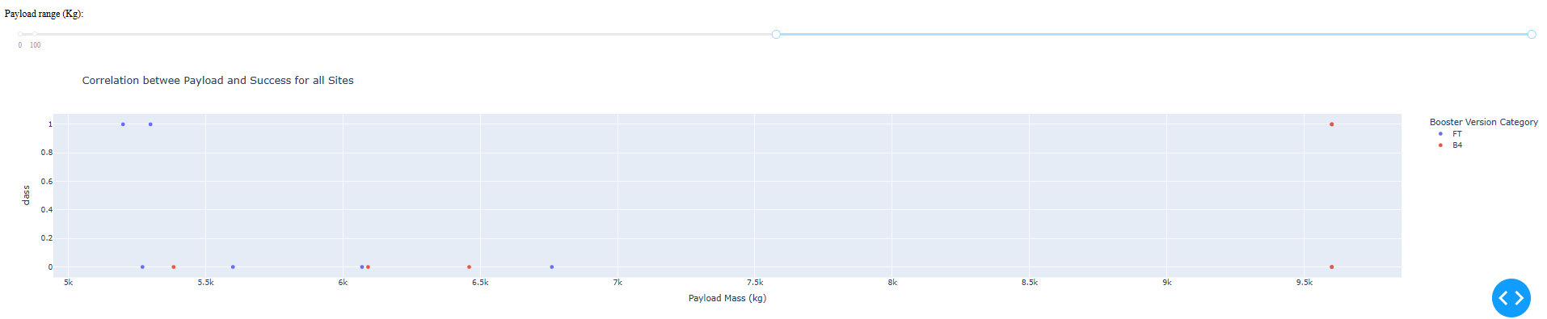
Payload vs. Launch Outcome scatter plot for all sites
Takeaway for full payload range: FT booster has the highest number of success launches
Takeaway for heavier payload range: the number of success launches is crucially diminished

Slide 44

Section 5

Slide 45
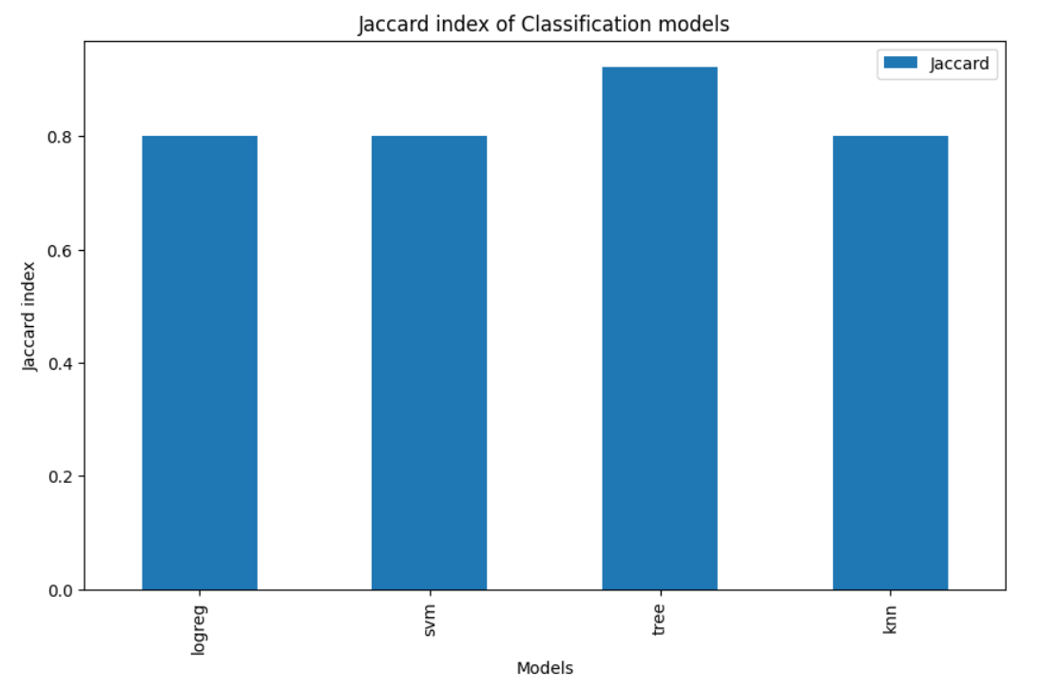
Classification Accuracy
Takeaway: the best classification model derived from Jaccard index using Test set to predict success of First Stage Landing is tree.

Slide 46
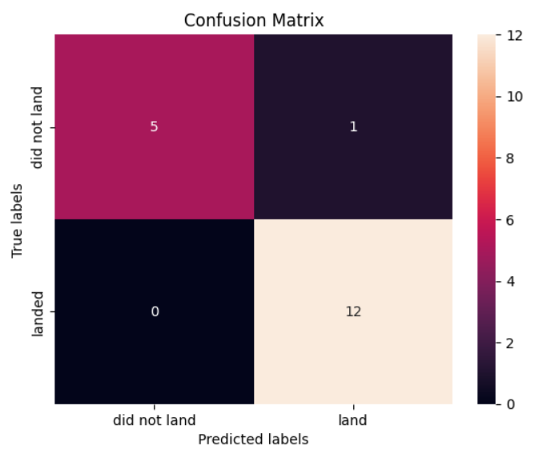
Confusion Matrix of Tree classification model
Tree classification model has predicted using the Test set:
- All 5 failures of the first stage landing
- 12 out of 13 successful first stage landing

Slide 47
Conclusions
We have chosen the following independent variables for our model: 'FlightNumber', 'PayloadMass', 'Orbit', 'LaunchSite', 'Flights', 'GridFins', 'Reused', 'Legs', 'LandingPad', 'Block', 'ReusedCount', 'Serial’
We have converted categorical variables Orbits, LaunchSite, LandingPad, and Serial into dummies variables.
Four models for classification prediction have been tested using the Test set: logistic regression SVM, tree and knn.
The best classification model derived from Jaccard index and 20% Test set to predict success of First Stage Landing is tree. Jaccard index for this model is 92.3%
Tuning parameters of the tree model are the following:
{'criterion': 'entropy', 'max_depth': 2, 'max_features': 'sqrt', 'min_samples_leaf': 1, 'min_samples_split': 10, 'splitter': 'best'}

Slide 48
Appendix
https://github.com/emerkushin/testrepo/blob/main/collect.ipynb
https://github.com/emerkushin/testrepo/blob/main/webscrap.ipynb
https://github.com/emerkushin/testrepo/blob/main/wrangle.ipynb
https://github.com/emerkushin/testrepo/blob/main/edadataviz.ipynb
https://github.com/emerkushin/testrepo/blob/main/eda_sql.ipynb
https://github.com/emerkushin/testrepo/blob/main/folium.ipynb
https://github.com/emerkushin/testrepo/blob/main/lab_dash.py
https://github.com/emerkushin/testrepo/blob/main/classification.ipynb

Slide 49


